Slide 1
Physical Layer
Transmission Modes
Modulation
Transmission Impairment
Multiplexing
Switching modes
Transmission medium

Slide 2
Transmission Modes Serial vs. parallel communications
In serial communications
A single bit will be transferred at a time using the communication channel
Bits will be reassembled at the destination
Mostly used by computer peripherals like printers
In parallel communications
Multiple bits (eg. Eight bits) will be transferred at a time
Needs multiple (parallel) communication channels

Slide 3
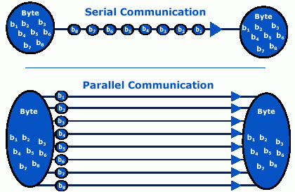

Slide 4
Serial transmission can be either asynchronous or synchronous.
Asynchronous Serial Transmission
It is named so because there is no importance of timing.
Data-bits have specific pattern and they help receiver recognize the start and end data bits.
For example, a 0 is prefixed on every data byte and one or more 1s are added at the end.
Two continuous data-frames (bytes) may have a gap between them.

Slide 5
Serial transmission can be either asynchronous or synchronous.
Synchronous Serial Transmission
Timing in synchronous transmission has importance as there is no mechanism followed to recognize start and end data bits.
There is no pattern or prefix/suffix method. Data bits are sent in burst mode without maintaining gap between bytes (8- bits). Single burst of data bits may contain a number of bytes. Therefore, timing becomes very important.
It is up to the receiver to recognize and separate bits into bytes. The advantage of synchronous transmission is high speed, and it has no overhead of extra header and footer bits as in asynchronous transmission.

Slide 6
Transmission Impairment
Signals travel through transmission media, which are not perfect. The imperfection causes signal impairment.
This means that the signal at the beginning of the medium is not the same as the signal at the end of the medium. What is sent is not what is received.
Three causes of impairment are attenuation, distortion, and noise.
Impairment Causes
Attenuation
Distortion
Noise

Slide 7
Attenuation
Attenuation means a loss of energy.
When a signal, travels through a medium, it loses some of its energy in overcoming the resistance of the medium.
That is why a wire carrying electric signals gets warm, if not hot, after a while. Some of the electrical energy in the signal is converted to heat.
To compensate for this loss, amplifiers are used to amplify the signal.
Attenuation is measured in terms of Decibels.
The decibel (dB) measures the relative strengths of two signals or one signal at two different points.
Note that the decibel is negative if a signal is attenuated and positive if a signal is amplified.

Slide 8
Distortion:
Distortion means that the signal changes its form or shape.
Distortion can occur in a signal made of different frequencies.
Each signal component has its own propagation speed through a medium and, therefore, its own delay in arriving at the final destination.
Differences in delay may create a difference in phase if the delay is not exactly the same as the period duration.

Slide 9
Noise
Noise is another cause of impairment. Several types of noise, such as Thermal noise, Induced noise, Crosstalk, and Impulse noise, may corrupt the signal.
Thermal noise is the random motion of electrons in a wire which creates an extra signal not originally sent by the transmitter.
Induced noise comes from sources such as motors and electrical device. These devices act as a sending antenna, and the transmission medium acts as the receiving antenna.
Crosstalk is called electromagnetic interference (EMI).It is the effect of one wire on the other. One wire acts as a sending antenna and the other as the receiving antenna.
Impulse noise is a spike (a signal with high energy in a very short time) that comes from power lines, lightning, and so on.

Slide 10
Modulation /Data encoding
Reading Assignment

Slide 11
Modulation
Modulation is the process of transforming a carrier signal so that it can carry the information of a message signal.
It superimposes the contents of the message signal over a high-frequency carrier signal, which is then transmitted over communication channels.
Modulation can be of two types −
Analog Modulation
Digital Modulation

Slide 12
Digital Data to Analog Signal Encoding Techniques
Modulation involves operation on one or more of the three characteristics of a carrier signal: amplitude, frequency, and phase.
Accordingly, there are three basic encoding or modulation techniques for transforming digital data into analog signals
Amplitude-shift keying (ASK)
Frequency-shift keying (FSK)
Phase-shift keying (PSK)

Slide 13
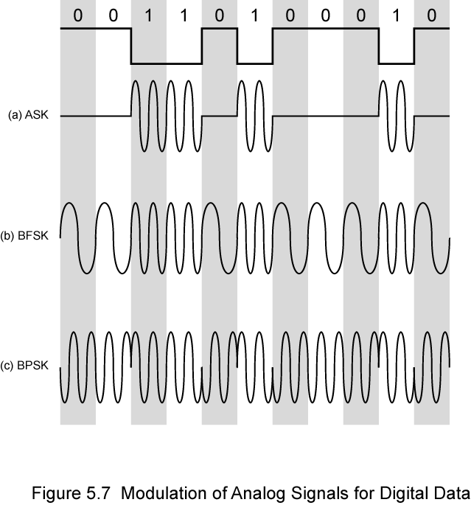

Slide 14
Analog Modulation
Here, the analog information signal is transformed to the analog carrier signal so that it can travel large distances without substantial loss.
Analog modulation can be of three types −
Amplitude Modulation
Frequency Modulation
Phase Modulation

Slide 15
Digital Modulation
Digital modulation is the process of converting a digital bit stream into an analog carrier wave for transmission via a communication channel.
Digital modulation is broadly divided into two categories −
Bandpass Modulation as in baseband transmission:
Here, the bits are converted directly into signals.
Passband Modulation as in passband transmission:
Here, the amplitude, phase or frequency of the carrier signal is regulated to transmit the bits.

Slide 16
Digital Modulation
Baseband Modulation
NRZ(Non return to zero)
Manchester Encoding
Passband modulation
ASK(Amplitude Shift Keying)
NRZI(NRZ invert)
FSK(Frequency Shift Keying)
PSK(Phase Shift Keying)
BPSK(Binary PSK)

Slide 17
DIGITAL TRANSMISSION
how to convert digital data into digital signals ?
It can be done in two ways:
line coding
block coding.
For all communications, line coding is necessary whereas block coding is optional.

Slide 18
Digital-to-Digital Conversion
line coding
block coding
Uni-polar
Bipolar
Polar :
4 types
Polar Non Return to Zero (Polar NRZ)
Return to Zero (RZ)
Manchester
Differential Manchester
involves three steps:
Division
Substitution
Combination.

Slide 19
Analog-to-Digital Conversion
Analog data is a continuous stream of data in the wave form whereas digital data is discrete. To convert analog wave into digital data, we use Pulse Code Modulation (PCM).
PCM is one of the most commonly used method to convert analog data into digital form. It involves three steps:
Sampling
Quantization
Encoding.

Slide 20
Assignment #1
Describe the following digital signal encoding formats (which format is used by Ethernet?)
Non return-to-Zero-Level (NRZ-L)
Non return to Zero Inverted (NRZI)
Bipolar-AMI
Pseudoternary
Manchester
Differential Manchester

Slide 21
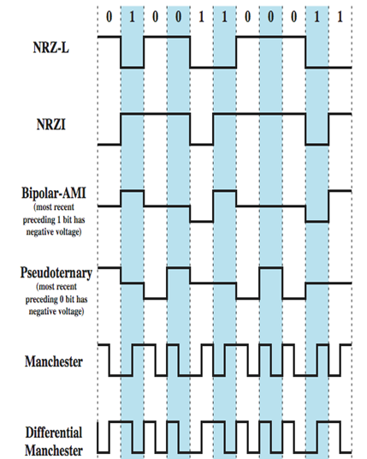
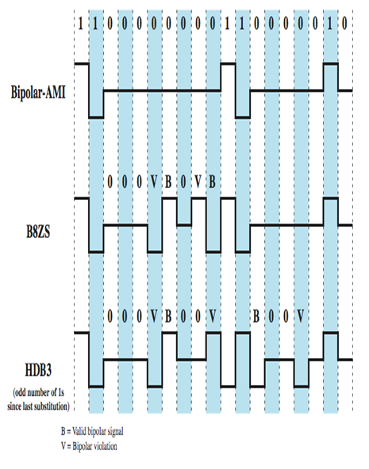

Slide 22
ANALOG TRANSMISSION
To send the digital data over an analog media, it needs to be converted into analog signal. There can be two cases according to data formatting.
Bandpass: The filters are used to filter and pass frequencies of interest. A bandpass is a band of frequencies which can pass the filter.
Low-pass: Low-pass is a filter that passes low frequencies signals.
When digital data is converted into a bandpass analog signal, it is called digital-to- analog conversion. When low-pass analog signal is converted into bandpass analog signal, it is called analog-to-analog conversion.

Slide 23
Digital-to-Analog Conversion
When data from one computer is sent to another via some analog carrier, it is first converted into analog signals. Analog signals are modified to reflect digital data.
An analog signal is characterized by its amplitude, frequency, and phase.
There are three kinds of digital-to-analog conversions:
Amplitude Shift Keying
Frequency Shift Keying
Phase Shift Keying

Slide 24
Analog-to-Analog Conversion
Analog signals are modified to represent analog data. This conversion is also known as Analog Modulation.
Analog modulation is required when bandpass is used.
Analog to analog conversion can be done in three ways:
Amplitude modulation
Frequency modulation
Phase modulation

Slide 25
multiplexing
MULTIPLEXING

Slide 26
Multiplexing
In data communication, there might be a need to share a single media for multiple communication (media/bandwidth sharing) in order to utilize the available bandwidth wisely to achieve specific goals.Sharing of a single media (fiber, coaxial, microwave,..) is known as multiplexing.
Whenever the bandwidth of a medium linking two devices is greater than the bandwidth needs of the devices, the link can be shared.

Slide 27
Contd.
This is a method of combining more than one signal over a shared medium.
Multiplexing divides the capacity of a communication channel into several logical channels, each for a data stream.
The method of extracting the original data streams from the multiplexed signal is called Demultiplexing.

Slide 28
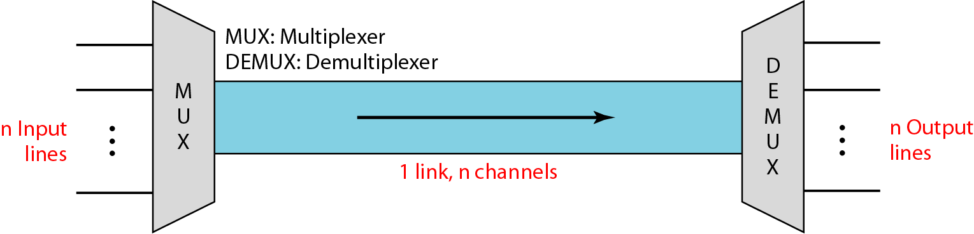
Contd.

Slide 29
Types of Multiplexing
Multiplexing
Frequency Division Multiplexing
Time Division Multiplexing
Code Division Multiplexing

Slide 30
Frequency-division Multiplexing (FDM)
It is an analog technology.
When the carrier is frequency ,FDM is used.
FDM can be used in both wired and wireless networking for transmitting large amounts of data at high speeds.
FDM is the simplest and oldest form of multiplexing in wireless networking technology.
FDM involves simultaneously transmitting multiple signals on different frequencies over the same line or channel.

Slide 31
Contd.
Channels can be separated by strips of unused bandwidth guard bands –to prevent signals from overlapping.
Signals from different data sources (f1,f2,f3…) are fed into a multiplexer that modulates each signal and transmits them at different frequencies.
These signals are then transmitted over the wire or through wireless communication and are separated at the destination into individual data signals using a demultiplexer.

Slide 32
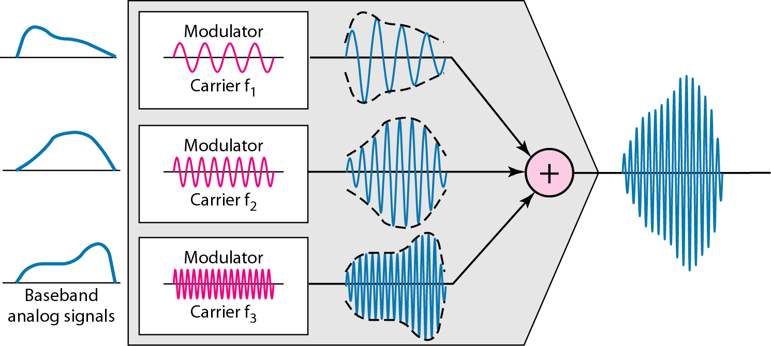
FD Multiplexing

Slide 33
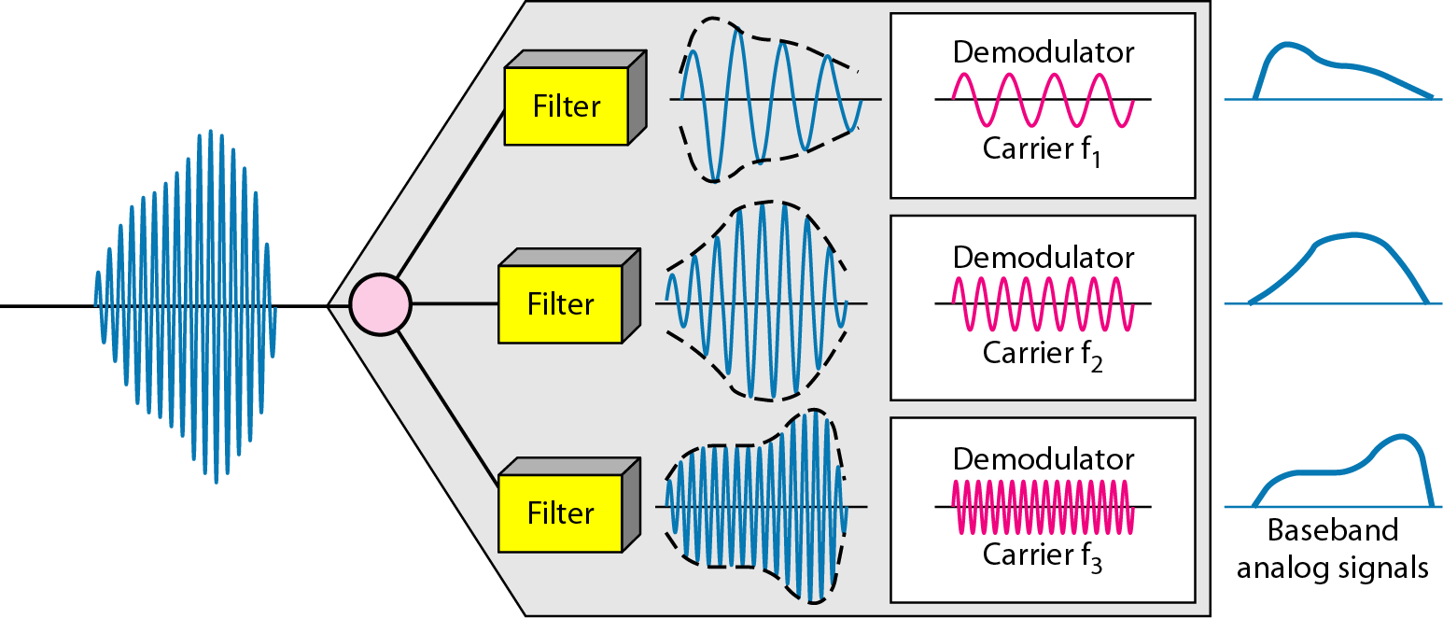
FD DEmultiplexing
Application of FDM
AM and FM radio broadcasting
Television broadcasting
The first generation of cellular telephones

Slide 34
Time-division multiplexing (TDM)
A digital process for transmitting multiple data streams in a single communication path.
Instead of sharing a portion of the bandwidth as in FDM, time is shared.
In TDM, the data from different input channels is divided into fixed-length segments and then combined in round-robin fashion into a single output data stream, which can then be transmitted over a single channel transmission system and DEmultiplexed at the destination location.

Slide 35
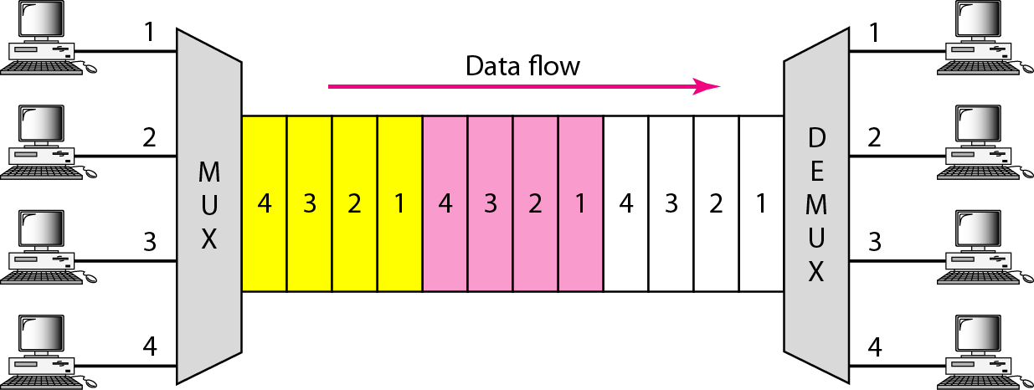
Contd.
TDM is a digital multiplexing technique for combining several low-rate digital channels into one high-rate one.

Slide 36
Contd.
One weakness in TDM is that if an input channel does not have anything important to carry for a time, empty segments are inserted into the output stream anyway.
For example, if channel A is not transmitting data, one-third of the output channel is not being used.
You can overcome this weakness by using a more sophisticated multiplexing technique called statistical multiplexing.

Slide 37
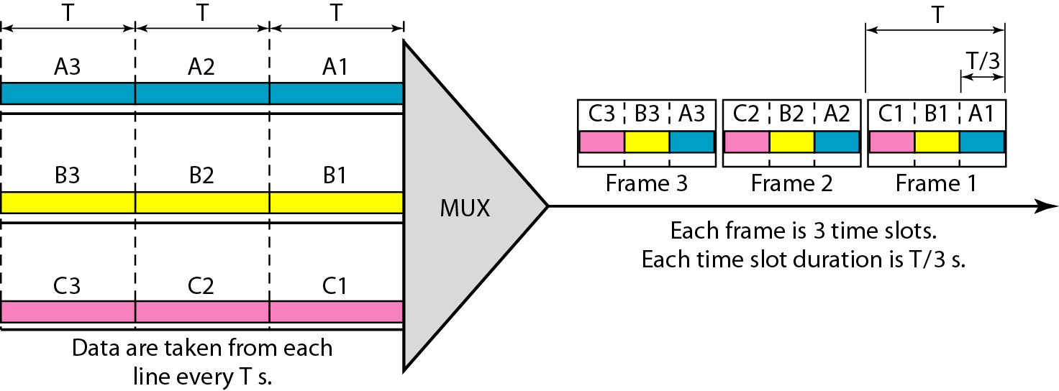
Contd.
For example, if input streams A, B, and C are divided into segments as shown here ( if we have n input lines then there are n slots in one frame)
A: A1, A2, A3,...
B: B1, B2, B3,...
C: C1, C2, C3,...
the output stream will look like this:
MUX(ABC) A1, B1, C1, A2, B2, C2, A3, B3, C3,...

Slide 38
Statistical Multiplexing
Asynchronous TDM (time slots are not fixed) , for n input lines m slots where m<n
allows information from a number of channels to be combined for transmission over a single channel.
It dynamically allocates bandwidth to each channel on an as-needed basis. This is in contrast to TDM, in which quiet devices use up a portion of the multiplexed data stream, filling it with empty packets.
Statistical multiplexing allocates bandwidth only to channels that are currently transmitting.

Slide 39
Statistical Multiplexing
It packages the data from the active channels into packets and dynamically feeds them into the output channel, usually on a FIFO (first in, first out) basis, but it’s also able to allocate extra bandwidth to specific input channels.
Statistical multiplexing is sometimes referred to as statistical time-division multiplexing (STDM)

Slide 40
switching
SWITCHING

Slide 41
Switching
Switching is a mechanism by which data/information sent from source towards destination which are not directly connected.
Networks have interconnecting devices, which receives data from directly connected sources, stores data, analyze it and then forwards to the next interconnecting device closest to the destination.

Slide 42
Switching
Switching
Circuit Switching
Message Switching
Packet Switching

Slide 43
Circuit Switching
When two nodes communicate with each other over a dedicated communication path, it is called circuit switching.
To transfer data circuit(permanent or temporary) must be established.
Establish a circuit ,transfer data ,disconnect the circuit
Designed for voice applications
Example : Telephone

Slide 44
Message Switching
In the middle of circuit switching and packet switching
The whole message is treated as a data unit and is switching /transferred in its entirety.
Store ,buffer ,forward
Disadvantage :
Every switch in transit path needs enough storage to accommodate entire message
Very slow
Not a solution for streaming media and real-time applications

Slide 45
Packet Switching
shortcomings of message gave birth to an idea of packet switching.
Entire message is broken down into smaller chunks called packets.
The switching information is added in the header of each packet and transmitted independently.
The internet uses packet switching.

Slide 46
Transmission medium
Transmission medium

Slide 47
Transmission medium
is the physical path between transmitter and receiver in a data transmission system.
Transmission media can be classified as guided or unguided.
In both cases, communication is in the form of electromagnetic waves.
With guided media, the waves are guided along a solid medium, such as copper twisted pair, copper coaxial cable, and optical fiber.
The atmosphere and outer space are examples of unguided media that provide a means of transmitting electromagnetic signals but do not guide them; this form of transmission is usually referred to as wireless transmission.

Slide 48
Contd.
Transmission Media
Guided(wired)
Unguided(wireless)
Air
Twisted pair cable
Coaxial Cable
Fiber Optics

Slide 49
Design Factors
A key concern is data rate and distance.
the greater the data rate and distance, the better.
A number of design factors relating to the transmission medium and to the signal determine the data rate and distance:
Bandwidth
Transmission impairments
Interference
A Number of receivers

Slide 50
Contd.
Bandwidth:-
All other factors remaining constant, the greater the bandwidth of a signal, the higher the data rate that can be achieved.
Transmission impairments:-
Impairments, such as attenuation, limit the distance.
For guided media, twisted pair generally suffer more impairment than coaxial cable, which in turn suffers more than optical fiber.

Slide 51
Contd.
Interference:-
Interference from competing signals in overlapping frequency bands can distort or wipe out a signal.
particular concern for unguided media, but it is also a problem with guided media.
For guided media, interference can be caused by emanations from nearby cables.
For example, twisted pair are often bundled together, and conduits often carry multiple cables. Proper shielding of a guided medium can minimize this problem.

Slide 52
Contd.
A Number of receivers:-
A guided medium can be used to construct a point-to-point link or a shared link with multiple attachments.
In a shared link , each attachment introduces some attenuation and distortion on the line, limiting distance and/or data rate.

Slide 53
GUIDED TRANSMSSION MEDIA
include twisted-pair cable, coaxial cable, and fiber-optic cable.
A signal traveling along any of these media is directed and contained by the physical limits of the medium.
Twisted-pair and coaxial cable use metallic (copper) conductors that accept and transport signals in the form of electric current.
Optical fiber is a cable that accepts and transports signals in the form of light.

Slide 54
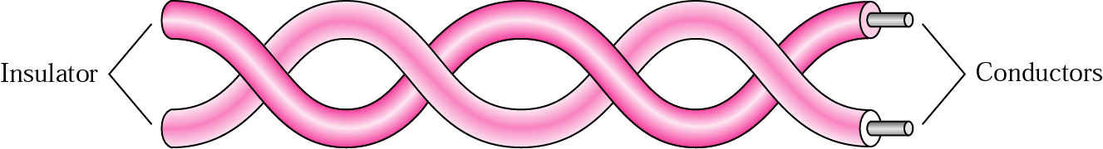
Twisted-Pair Cable
consists of two conductors (normally copper), each with its own plastic insulation, twisted together, as shown in the figure below
One of the wires is used to carry signals to the receiver, and the other is used only as a ground reference.
The receiver uses the difference between the two.
In addition to the signal sent by the sender on one of the wires, interference (noise) and crosstalk may affect both wires and create unwanted signals.
the number of twists per unit of length (e.g., inch) has some effect on the quality of the cable.

Slide 55
Unshielded Versus Shielded Twisted-Pair Cable
The most common twisted-pair cable used in communications is referred to as unshielded twisted-pair (UTP).
IBM has also produced a version of twisted-pair cable for its use called shielded twisted-pair (STP).
STP cable has a metal foil or braided mesh covering that encases each pair of insulated conductors. Although metal casing improves the quality of cable by preventing the penetration of noise or crosstalk, it is bulkier and more expensive.

Slide 56
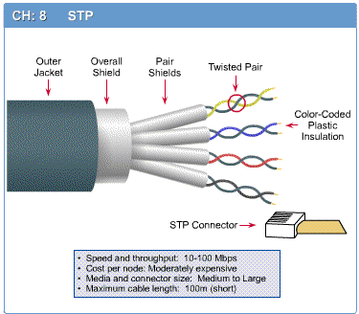
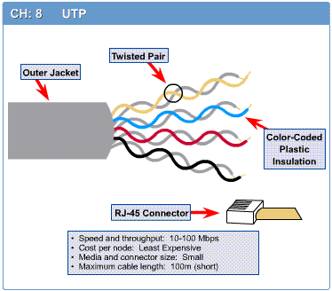
STP
UTP
Notes:
STP

Slide 57
UTP Categories
The Electronic Industries Association (EIA) has developed standards to classify unshielded twisted-pair cable into seven categories.
Categories are determined by cable quality, with 1 as the lowest and 7 as the highest.
Each EIA category is suitable for specific uses.

Slide 58
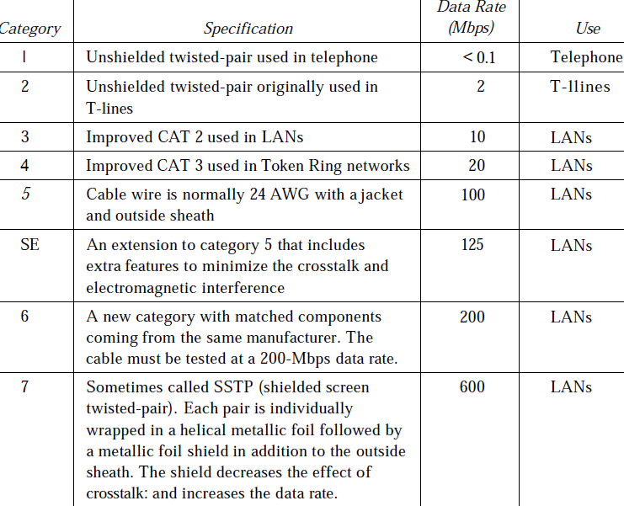


Slide 59
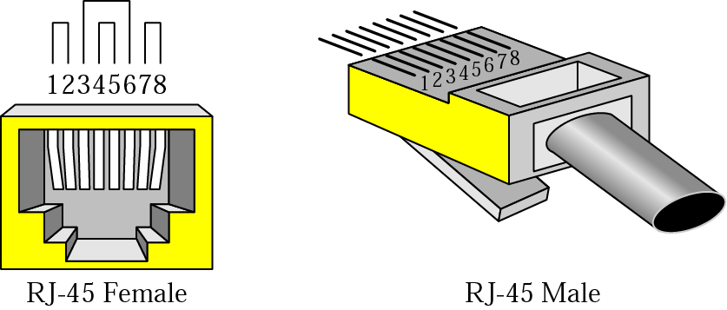
Connectors
The most common UTP connector is RJ45 (RJ stands for registered jack). The RJ45 is a keyed connector, meaning the connector can be inserted in only one way.

Slide 60
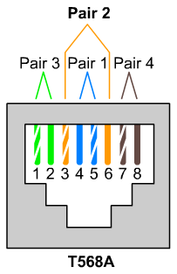
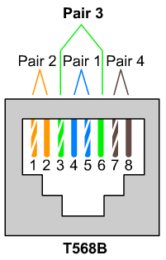
RJ-45 connector
A straight-through cable has T568B on both ends.
A crossover (or cross-connect) cable has T568B on one end and T568A on the other.
A console cable had T568B on one end and reverse T568B on the other, which is why it is also called a rollover cable.

Slide 61
When to use ?
Use straight-through cables for the following cabling:
Switch to router
Switch to PC or server
Hub to PC or server
Use rollover cable
used to connect a computer terminal to a router's console port.
Use crossover cables for the following cabling:
Switch to switch
Switch to hub
Hub to hub
Router to router
PC to PC
Router to PC

Slide 62
Twisted-pair cable Applications
Within buildings
Most common medium
Twisted-pair cables are used in telephones lines to provide voice and data channels.
The DSL lines that are used by the telephone companies to provide high data rate connections also use the high-bandwidth capability of unshielded twisted-pair cables.
Local area networks, such as 10Base-T and 100Base-T, also used UTP cables.

Slide 63
Coaxial Cable
outer jacket
(polyethylene)
Outer Conductor
Shield (braided wire)
insulating material
(Insulator)
Inner copper or aluminum
conductor

Slide 64
Coaxial Cable
Coaxial cable (or coax) carries signals of higher frequency ranges than those in twisted pair cable, in part because the two media are constructed quite differently.
Instead of having two wires, coax has a central core conductor of solid or stranded wire (usually copper) enclosed in an insulating sheath, which is, in turn, encased in an outer conductor of metal foil, braid, or a combination of the two.
The outer metallic wrapping serves both as a shield against noise and as the second conductor, which completes the circuit. This outer conductor is also enclosed in an insulating sheath, and the whole cable is protected by a plastic cover

Slide 65
Contd.
At one time, coaxial cable was the most widely used network cabling. There were a couple of reasons for coaxial cable's wide usage:
it was relatively inexpensive
it was light, flexible, and easy to work with.

Slide 66
Contd.
Shielding protects transmitted data by absorbing stray electronic signals, called noise, so that they do not get onto the cable and distort the data.
Cable that contains one layer of foil insulation and one layer of braided metal shielding is referred to as dual shielded.
For environments that are subject to higher interference, quad shielding is available.
Quad shielding consists of two layers of foil insulation and two layers of braided metal shielding.

Slide 67
Types of Coaxial Cable
Thin (thinnet) cable
Thick (thick net) cable
Thinnet(10Base2):-
is a flexible coaxial cable about 0.64 centimeters (0.25 inches) thick.
distance of up to approximately 185 meters
Because this type of coaxial cable is flexible and easy to work with
it can be used in almost any type of network installation.

Slide 68
Types of Coaxial Cable: Thicknet(10Base5)
is a relatively rigid coaxial cable about 1.27 centimeters (0.5 inches) in diameter.
is sometimes referred to as Standard Ethernet because it was the first type of cable used with the popular network architecture Ethernet.
is thicker than a thinnet cable core.
thick net can carry signals farther than thinnet cable. Thicknet cable can carry a signal for 500 meters (about 1640 feet).
used as a backbone to connect several smaller thin net-based networks

Slide 69
Thin net vs. Thick net
The thicker the cable, the more difficult it is to work with.
Thin cable is flexible, easy to install, and relatively inexpensive.
Thick cable does not bend easily and is, therefore, harder to install.
Thick cable is more expensive than thin cable, but will carry a signal farther.

Slide 70
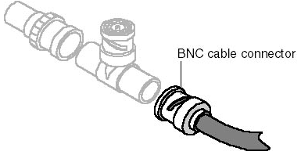
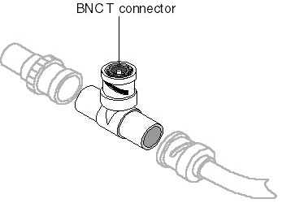
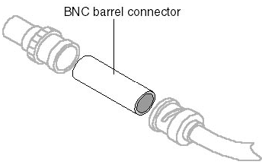
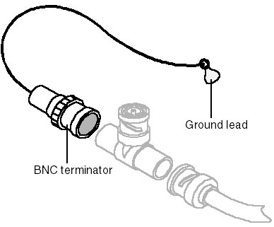
Connector

Slide 71
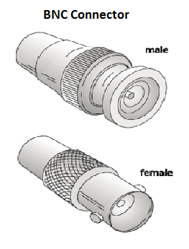
BNC connector
BNC T connector is used to connect the end of the cable to a device, such as a TV set.
The BNC T connector is used in Ethernet networks to branch out to a connection to a computer or other device.
The BNC terminator is used at the end of the cable to prevent the reflection of the signal
BNC barrel connector is used to join two lengths of thinnet cable to make one longer length.

Slide 72
Category | Impedance | Use
RG-59 | 75 Ω | Cable TV
RG-58 | 50 Ω | Thin Ethernet
RG-11 | 50 Ω | Thick Ethernet
Categories of coaxial cables
Coax advantages
It is less susceptible to interference than twisted-pair cable.
Transmit data for greater distances than is possible with less expensive cabling.
Transmit voice, video, and data
Offer a familiar technology with reasonable data security.
Coax disadvantages
There are many types of coax cables, each suited for one, or at most, a small number of LAN systems.
Due to its high metallic content, coax cable is usually more expensive than other cable types.

Slide 73
Coaxial Cable Applications
Most versatile medium
Television distribution
Ariel to TV
Cable TV
Long distance telephone transmission
Can carry 10,000 voice calls simultaneously
Being replaced by fiber optic
Short distance computer systems links
Local area networks

Slide 74
Fiber-Optic Cable
is made of glass or plastic and transmits signals in the form of light.
consists of a signal-carrying glass core of 5 to 100 microns in diameter (a sheet of paper is about 25 microns thick and a human hair about 75 microns thick), surrounded by a layer of pure silica called cladding, which prevents light from escaping.
Surrounding the cladding are protective layers of acrylic plastic coating, Kevlar fibers for additional strength, and a PVC (polyvinyl chloride) jacket (usually colored a distinctive orange).

Slide 75
Contd.
Network components use LED or laser diodes to convert electrical signals into light pulses for transmission on fiber-optic cables.
An optical detector is used to convert the light pulses back into electrical signals.

Slide 76
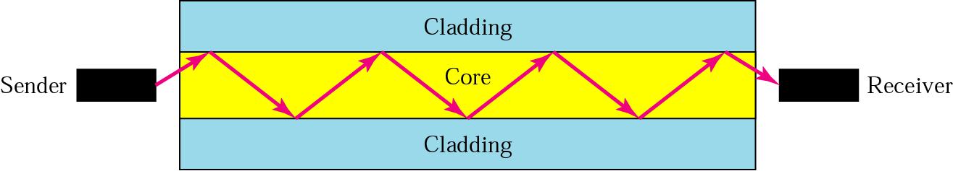
Contd.
Optical fibers use reflection to guide light through a channel.
A glass or plastic core is surrounded by a cladding of less dense glass or plastic.
The difference in density of the two materials must be such that a beam of light moving through the core is reflected off the cladding instead of being refracted into it (cladding)

Slide 77
Optical Fiber - Applications
Long-haul trunks
Metropolitan trunks
Rural exchange trunks
Subscriber loops
LANs

Slide 78
Advantages of Optical Fiber
The major advantages offered by fiber-optic cable over twisted-pair and coaxial cable are noise resistance, less signal attenuation, and higher bandwidth.
Noise Resistance: Because fiber-optic transmission uses light rather than electricity, noise is not a factor. External light, the only possible interference, is blocked from the channel by the outer jacket.
Less signal attenuation:- Fiber-optic transmission distance is significantly greater than that of other guided media. A signal can run for miles without requiring regeneration.
Higher bandwidth:- Currently, data rates and bandwidth utilization over fiber-optic cable are limited not by the medium but by the signal generation and reception technology available.

Slide 79
Disadvantages of Optical Fiber
The main disadvantages of fiber optics are cost, installation/maintenance, and fragility.
Cost:- Fiber-optic cable is expensive. Also, a laser light source can cost thousands of dollars, compared to hundreds of dollars for electrical signal generators.
Installation/maintenance
Fragility:- Glass fiber is more easily broken than wire, making it less useful for applications where hardware portability is required.

Slide 80
Unguided (Wireless) Media
Unguided media transport electromagnetic waves without using any physical conductor.
This type of communication is often referred to as wireless communication.
Signals are normally broadcast through free space and thus are available to anyone who has a device capable of receiving them.

Slide 81
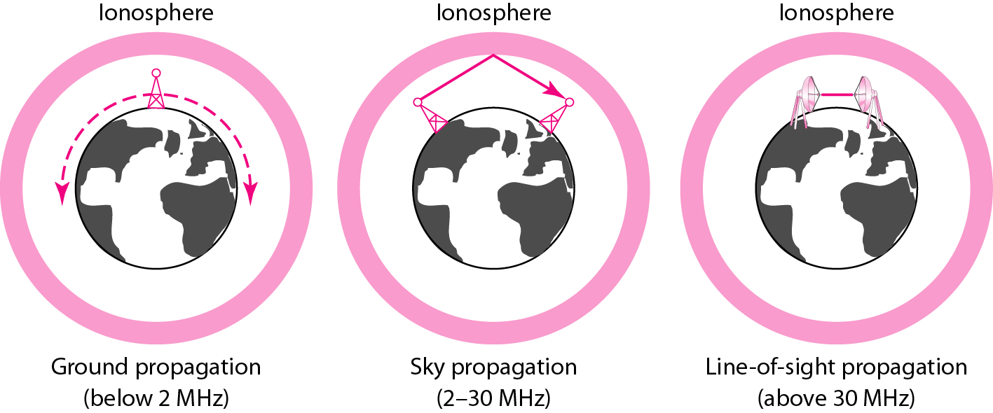
Unguided (Wireless) Media
Unguided signals can travel from the source to destination in several ways: ground propagation, sky propagation, and line-of-sight propagation.

Slide 82
Contd.
In ground propagation
radio waves travel through the lowest portion of the atmosphere, hugging the earth.
These low-frequency signals emanate in all directions from the transmitting antenna and follow the curvature of the planet.
Distance depends on the amount of power in the signal: The greater the power, the greater the distance.

Slide 83
Contd.
2.In sky propagation
higher-frequency radio waves radiate upward into the ionosphere (the layer of atmosphere where particles exist as ions) where they are reflected back to earth.
This type of transmission allows for greater distances with lower output power.

Slide 84
Contd.
In line-of-sight propagation
very high-frequency signals are transmitted in straight lines directly from antenna to antenna.
Antennas must be directional, facing each other, and either tall enough or close enough together not to be affected by the curvature of the earth.

Slide 85
Wireless Transmission Types
Wireless transmission
Radio wave
Micro wave
Infrared

Slide 86
Radio Waves
waves that are transmitted in all the directions of free space.
are omnidirectional, i.e., the signals are propagated in all the directions.
The range in frequencies of radio waves is from 3Khz to 1 khz.
In the case of radio waves, the sending and receiving antenna are not aligned, i.e., the wave sent by the sending antenna can be received by any receiving antenna.
An example of the radio wave is FM radio.

Slide 87
Microwaves
Frequency range: The frequency range of terrestrial microwave is from 4-6 GHz to 21-23 GHz.
Bandwidth: It supports the bandwidth from 1 to 10 Mbps.
Short distance: It is inexpensive for short distance.
Long distance: It is expensive as it requires a higher tower for a longer distance.
Attenuation: It is affected by environmental conditions and antenna size.
Microwaves are unidirectional. When an antenna transmits microwave waves, they can be narrowly focused. (the sending and receiving antennas need to be aligned /see each other).

Slide 88
Infrared
An infrared transmission is a wireless technology used for communication over short ranges.
The frequency of the infrared in the range from 300 GHz to 400 THz.
It is used for short-range communication such as data transfer between two cell phones, TV remote operation, data transfer between a computer and cell phone resides in the same closed area.

Slide 89
?

